Slide 1
DES Implementation
(Data Encryption Standard)
Under the
Guidance of:
Dr. Arup Kr. Pal
Akshay Dobariya
16JE001934
4th semester
B.tech CSE

Slide 2
Key generation
Remember that the original key is 64 bits long. But not all of it is used. The last bit of each byte are left (i.e. every eigth bit is ignored), and only the 64-8 = 56 bits are used. What happens on these 56 bits that yields sixteen 48-bit keys? Let's see now. 1- 56 bits are permuted. 2- This permutation divided into two equal halves, say C and D. 3- Both halves are separately 'left-shifted'. (circular shifts by 1 or 2 bits) 4- These two halves are passed to the 'Permuted Choice Table 2' to produce a 48-bit 'key'; and also... 5- ...These two halves serve as input to the next round. The process from steps 2 to 5 are repeated 16 times, and in the end, 16 'keys' (48-bit Keys) are prepared. This is how the sixteen 48-bit keys are prepared. (and then used in each round).

Slide 3
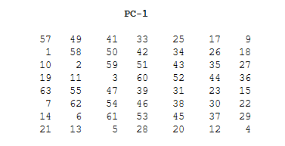
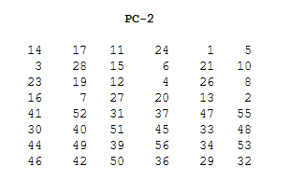
Permutation choice :1
Permutation choice :2

Slide 4
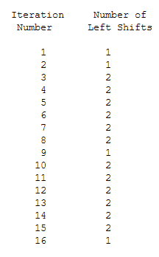
Iteration table

Slide 5
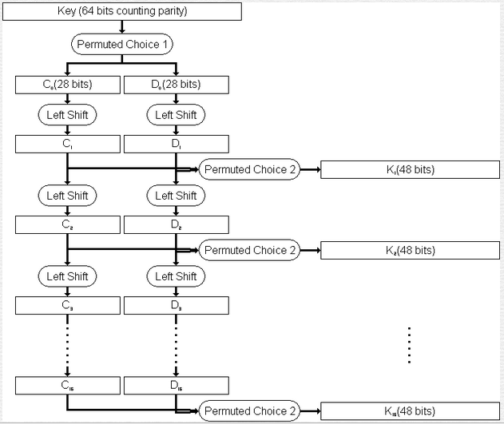

Slide 6

Equation

Slide 7
Function(f)
It can be understood as follows: 1- the 32 bit right half, using the E table (Expansion/Permutation Table), gives 48 bits. 2- 48 bits of 'key'(?) are also available. 3- These two are XORed. 4- The resultant 48 bits passed through Substitution Box (S-Box), to produce 32 bits. 5- These 32 bits passed through another P (Permutation). That's it. In the end, the result obtained is the output of the 'function'. (and is XORed with the left half in each round) That was about the 'function', f, in each round.

Slide 8
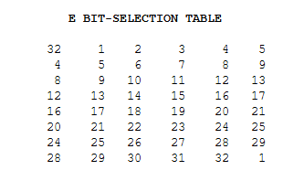
Internal function :E()

Slide 9
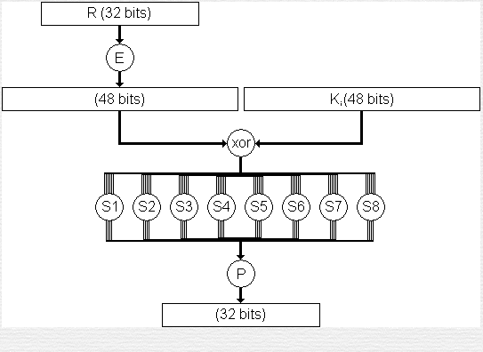
Function :f()

Slide 10
Message encryption
It can be understood shortly as this: 1- an initial permutation of 64 bits of plaintext 2- dividing the block of 64 bits into two halves 3- right half becomes new left half, and 4- left half XORed with a 'function' (of right half and a '48 bit key'?) 5- 16 such rounds. That's it. In the end, you've got the ciphertext bits. Now, few things need to be elaborated further. Firstly, what is the 'function' in each round; Secondly, what is the 48 bit 'key' in each round.

Slide 11
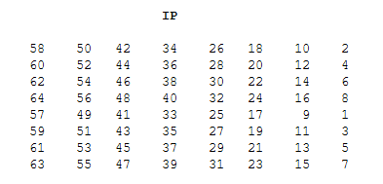
Initial message permutation

Slide 12
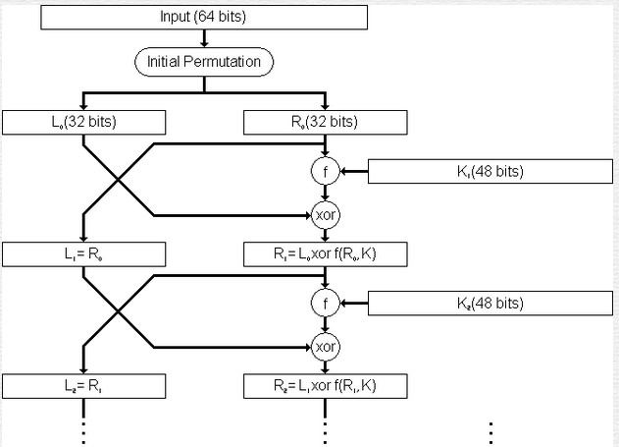

Slide 13
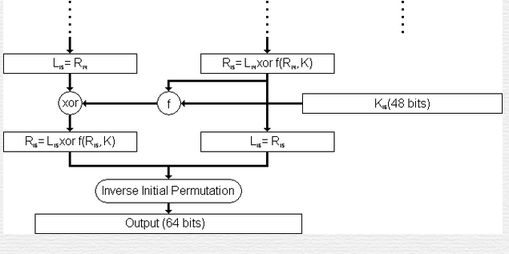

Slide 14
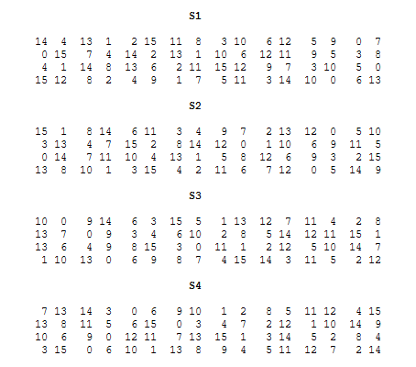
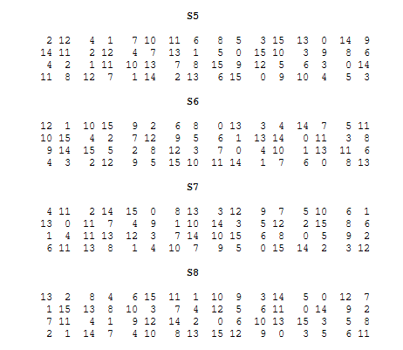
S-blocks

Slide 15
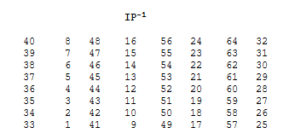
IP inverse

